Slide 1
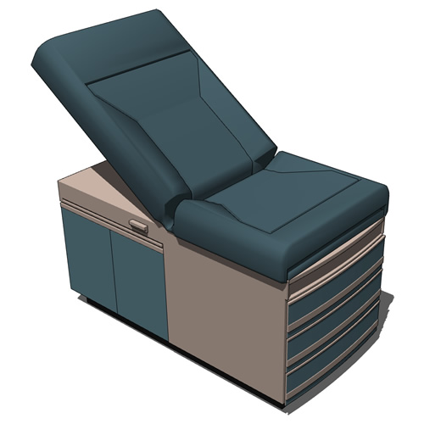
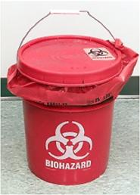
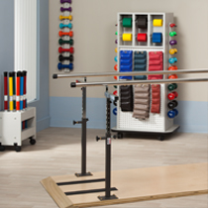
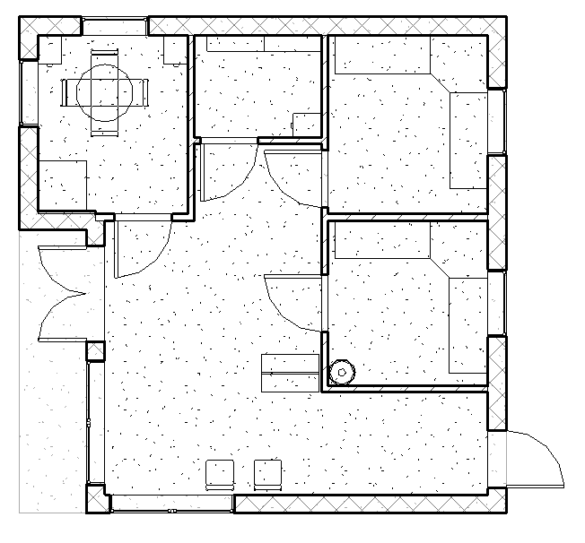
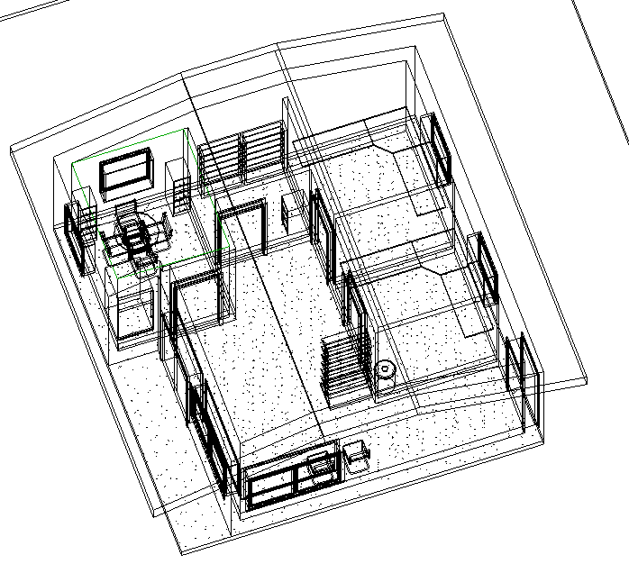
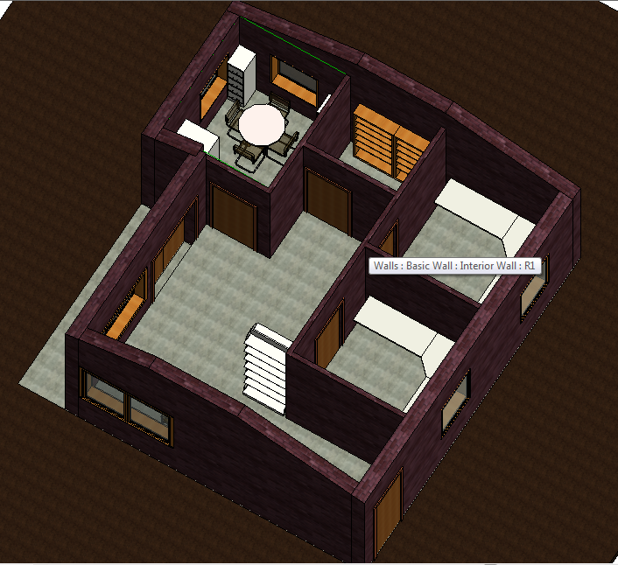
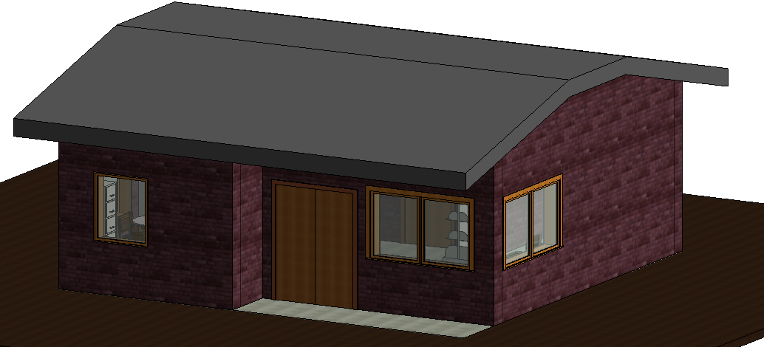
Proposed Health Center for Sierra Leone
Kelly Bresnowitz, Jamey Hogarth, Rachel Lacek, Kaylee Werner
Goal:
Design a health center for general health to be built in various locations in Africa. It needs to be easy to clean so viruses can not be spread by contact with the surfaces. It needs to have a friendly atmosphere so patients are not scared to come and get treated. Ebola patients will be treated else where.
Materials
Mud Brick
Corrugated Steel
Windows
Wood Doors
Wood
Concrete
Plastic Netting
Sealant
Thatch
Nails
Screws
Concrete
Design
Water runoff inside for easy cleaning
Patient friendly image
Sealed concrete and mud brick
Thatch roof to maintain indoor temperature
Sealed concrete floors
Africa Information:
Lowest Recorded Temperature in Africa: -11°F
Highest Recorded Temperature in Africa: 131°F
Wind Speeds: 0-10 mph
SIERRA LEONE:
Average Temperature: 73-88 °F
Ranges between tropical and savannah climate conditions
Rainfall: 110inches/year
Humidity: 80-91%
Furnishings:
Sterilization and Treatment Room:
Hazardous Waste Bin
Trash Can
Doctor’s Table
Counter
Sink
Observation Room:
Doctor’s Table
Sink
Counter
Storage:
Cabinets
Shelves
Scrubs Closet
Meeting Room:
Meeting Table
Chairs
File Cabinets
PT Room
Fans
Water Filtering System
Work-Out Machines
Mats
Railings
Small Weight Rack
Room Purpose:
Sterilization Room:
Room used to treat patients that are sick.
Observation Room:
A place where doctors see patients and determine what treatment they need.
Storage:
Store all scrubs, medical equipment, medication, cleaning supplies
Meeting Room:
A place for medical personnel to meet and discuss plans of action.
Hold records of patients and those who have passed away
PT Room:
Rehabilitation place for patients to work on strength and cardio
Ebola Basics:
Symptoms: Fever, sore throat, muscle pain and headaches then, vomiting, diarrhea and rash
Signs and symptoms typically start between two days and three weeks after contracting the virus.
The virus is acquired by contact with blood or other body fluids of an infected human or animal.
Can be spread by coming in contact with recently contaminated item or surface.
Kills between 25% and 90% of those infected with the virus, averaging out at 50%.
No known treatment
Basic Floor Plan
3D Wire Frame View
Interior View
Exterior View

